Slide 1

WEB Development
Grade 7&8

Slide 2
Recap of the last Class
Notes:
Objective:
Review the previous lesson on HTML tables.
Introduce the new topic: HTML forms.
Teacher Instructions:
Recap the key points from the last lesson:
Discuss how HTML tables organize data into rows and columns.
Introduce today's topic:
Explain that today, students will shift their focus to HTML forms.
Discuss the purpose of HTML forms in collecting and submitting data.
Encourage interactive discussion and exploration of form elements like text inputs, checkboxes, and submit buttons.

Slide 3

Mia's Pantry Puzzle
In a village, a cook named Mia had three ingredients: garlic, potato, and carrot. She had two shelves and could only place one ingredient on each shelf at a time.
If garlic was left alone with potato, it would spoil the potato. If potato was left alone with carrot, it would sprout and ruin the carrot.
How can Mia store all three ingredients without any of them being spoiled or ruined?
Notes:
Answer:
First, Mia places the potato on the first shelf. Then, she places the garlic on the second shelf. Mia takes the potato from the first shelf and temporarily holds it.
She then places the carrot on the first shelf. Finally, she places the potato on the second shelf along with the garlic.
Objective:
Engage students with a problem-solving activity.
Teacher Instructions:
Present the riddle:
"Mia, a cook in a village, has three ingredients: garlic, potato, and carrot. She has only two shelves and can only place one ingredient on each shelf at a time. If garlic is left alone with potato, it will spoil the potato.
If potato is left alone with carrot, it will sprout and ruin the carrot. How can Mia store all three ingredients without any of them being spoiled or ruined?"
Discuss possible solutions and encourage creative thinking.

Slide 4

Introduction to Forms
Notes:
Objective:
Introduce the concept of forms in HTML.
Teacher Instructions:
Show the image attached to the slide.
Explain the purpose of forms:
- "Forms in HTML allow us to collect information from users and send it to a server for processing."
Discuss the versatility of forms:
- Mention that forms can include various elements like text fields, checkboxes, radio buttons, and submit buttons.
- Emphasize how forms enhance interactivity and functionality on websites by facilitating user input and interaction.
Encourage students to explore different form elements and their uses in real-world scenarios during the lesson.

Slide 5

Emily's Thanksgiving Dinner Planning
Emily, a bright and enthusiastic fifth-grader, was tasked with organizing the family’s Thanksgiving dinner this year. She wanted to make sure everyone had a say in the meal, so she decided to gather everyone's favorite foods and recipes. Emily thought this would be a fun way to include everyone in the planning and ensure there was something for everyone at the table.
To gather this information efficiently, Emily considered asking each family member individually. However, with many relatives to reach out to, she quickly realized this method would be too time-consuming. She needed a better solution.
So, what could Emily do to save her time?
Notes:
Objective:
Engage students with a practical example of using HTML forms for gathering information.
Teacher Instructions:
To save time, Emily could create an online form using HTML. This way, she could send the form to all her family members via email or a messaging app, allowing them to fill it out at their convenience. By using an online form, Emily can gather all the information in one place quickly and efficiently without having to ask each person individually. This method not only saves her time but also ensures that everyone’s preferences are recorded accurately.

Slide 6
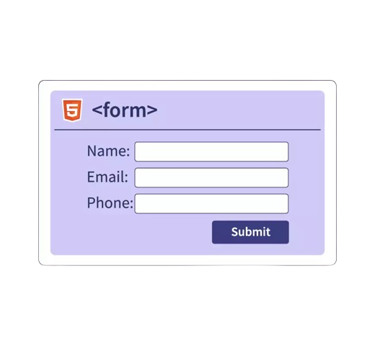
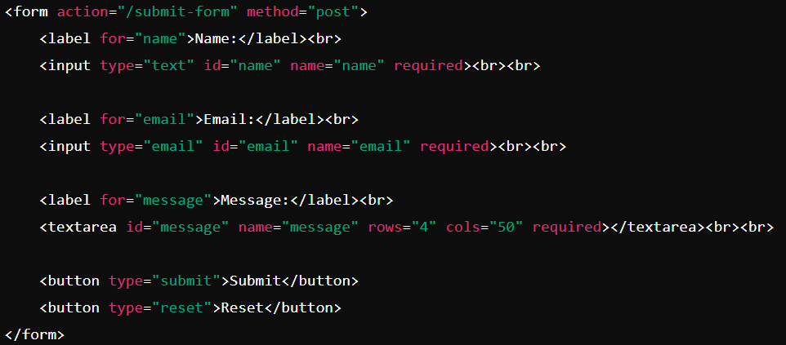
Introduction to Forms
HTML forms allow us to gather and organize user input.
How it Looks:
Notes:
Objective:
Explain the basic structure of HTML forms
Teacher Instructions:
Show the screenshot of the form syntax.
Explain the key elements of a form
<form>: This tag defines the start of a form.
<label>: This tag defines a label for an input field.
<input>: This tag defines various types of input fields where users can enter data.
<textarea>: This tag defines a multiline text input field.
<button>: This tag defines a clickable button within the form.
Discuss how labels associate text with input fields, input fields capture user data, textareas allow for longer responses, and buttons trigger actions like submitting the form or resetting input fields. Illustrate how these elements work together to create effective forms for user interaction on websites.

Slide 7
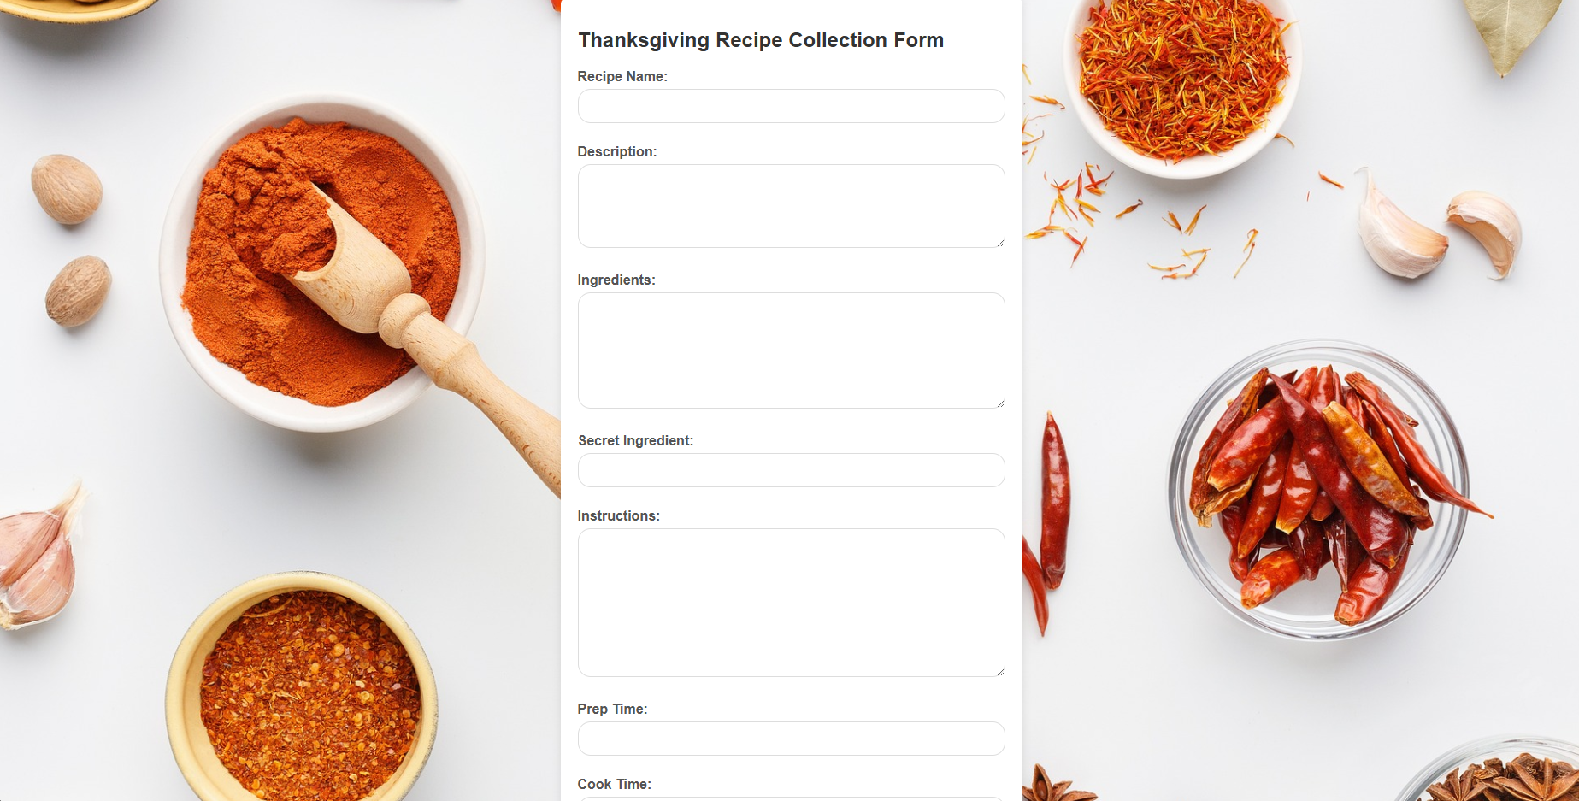
Project – Thanksgiving Recipe Collection Form
Notes:
Project Link: Receipe Form Lesson 9 - Replit
Objective:
Present the final project example.
Teacher Instructions:
Show the screenshot of the final project.
Explain that students will create a similar project.

Slide 8
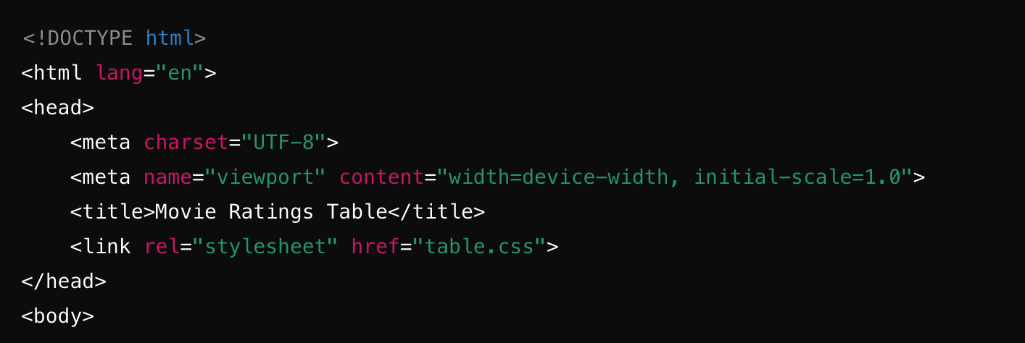
Working with the Project
HTML Code Explanation
Basic Structure of an HTML Document
Notes:
"Teacher's Activity"
Objective:
Explain the basic structure of an HTML document.
Teacher Instructions:
Display the screenshot of the HTML code.
Provide an overview of the basic structure:
<!DOCTYPE html>: Specifies HTML5.
<html lang="en">: Starts the HTML document with English language.
<head>: Contains meta-information.
Various meta tags for character set, viewport, and title.
<link>: Links to an external CSS file.

Slide 9
Working with the Project
Body of the HTML Document
<div class="form-container">: This <div> element with the class attribute form-container is used to group and organize the elements of the form together.
Notes:
Objective:
Explain the body of the HTML document.
Teacher Instructions:
It helps to visually organize and style the form elements within a specific section of the webpage.
By enclosing the form elements within this <div>, we can apply CSS styles or manipulate the form layout more effectively.

Slide 10
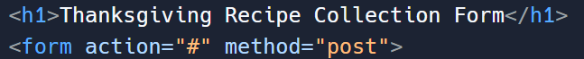
Working with the Project
Adding Heading and Form Tag
<form action="#" method="post">: This <form> element marks the beginning of the form section in the HTML document.
action="#": The action attribute determines where to send the form data upon submission. Here, # indicates that the form data will be processed on the current page itself.
method="post": The method attribute specifies how the form data will be sent to the server. Using post ensures that data is sent in a way that is not visible in the URL.
Notes:
Objective:
Explain how to add Form tag to the HTML document.
Teacher Instructions:
Display the screenshot of the HTML code.
Explain the form element:
<form action="#" method="post">: This <form> element defines the start of the form section in the HTML document.
action="#": The action attribute specifies where to send the form data when it is submitted. Here, # represents the current page itself.
method="post": The method attribute specifies how to send the form data to the server. post method sends data in a way that is not visible in the URL.

Slide 11
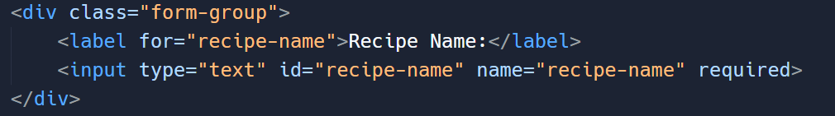
Working with the Project
Creating the Table: Part 1 - Table and Header Row
<div class="form-group">: Groups form elements for styling.
<label for="recipe-name">Recipe Name:</label>: Labels input field.
<input type="text" id="recipe-name" name="recipe-name" required>: Text input for recipe name.
Notes:
Objective:
Explain how to create the label and input.
Teacher Instructions:
Display the screenshot of the HTML code.
Explain the Code
<div class="form-group">: Groups related form elements for styling.
<label for="recipe-name">Recipe Name:</label>: Provides a label for the input field.
<input type="text" id="recipe-name" name="recipe-name" required>: Allows users to enter the recipe name. The required attribute ensures this field must be filled out before submitting the form.

Slide 12
Working with the Project
Understanding how to create text area
<textarea>: This HTML element creates a multiline text input field where users can enter longer text.​
id="description": The id attribute uniquely identifies the textarea element, which can be referenced by labels or scripts.​
name="description": Provides the name of the textarea element, which is used to identify the form data when submitted to a server.​
rows="4": Specifies the visible height of the textarea, sets initial visible lines to 4
Notes:
Objective:
Explain how to create the first row of data in the table.
Teacher Instructions:
Display the screenshot of the HTML code.
Explain the text area code:
<textarea> creates a multiline text input field.
id="description" uniquely identifies the textarea.
name="description" provides its name for form submission.
rows="4" sets initial visible lines to 4.
required ensures it must be filled before submission.

Slide 13
Working with the Project
Understanding Different Types of HTML Input Elements
<input type="text">: Creates a single-line text input field for general text input.
<input type="number">: Provides a numeric input field where users can enter numbers. It may include controls for incrementing or decrementing values.
<input type="password">: Masks the input characters for secure entry, commonly used for passwords.
Notes:
Objective:
Present the following types of HTML input elements to the class

Slide 14
Working with the Project
Understanding Different Types of HTML Input Elements
<input type="radio">: Allows users to select one option from a list of predefined choices. Radio buttons are typically grouped using the name attribute.
<input type="date">: Presents a date picker interface for selecting dates. The format may vary depending on the browser and user locale.
<input type="checkbox">: Displays a checkbox that users can select or deselect independently of other checkboxes. It's used for boolean options.
Notes:
Objective:
Present the following types of HTML input elements to the class

Slide 15
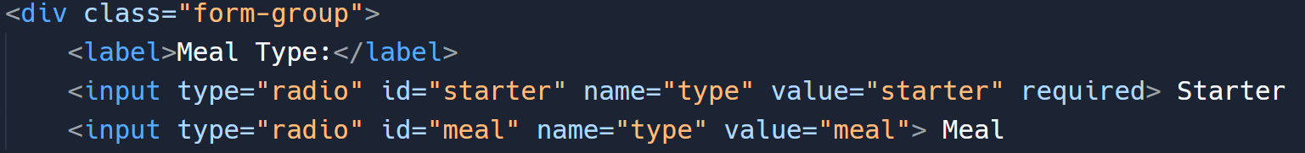
Working with the Project
Radio Button's
<input type="radio" id="starter" name="type" value="starter" required>: Radio button for selecting "Starter".
id="starter" uniquely identifies this radio button.
name="type" groups radio buttons together (useful for selecting only one option).
value="starter" provides the value submitted if this option is selected.
Notes:
Objective:
Explain how to create the label and input.
Teacher Instructions:
Display the screenshot of the HTML code.
Explain the Code
<input type="radio" id="starter" name="type" value="starter" required>: Radio button for selecting "Starter".
id="starter" uniquely identifies this radio button.
name="type" groups radio buttons together (useful for selecting only one option).
value="starter" provides the value submitted if this option is selected.
required attribute ensures that one option must be selected before submitting the form.

Slide 16
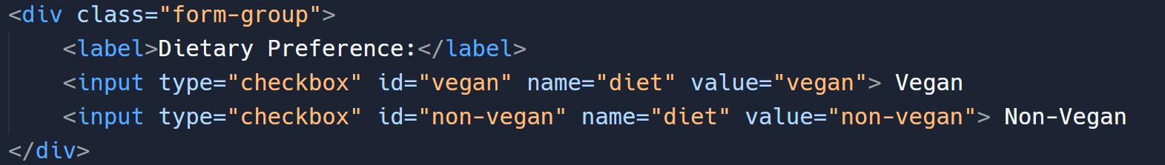
Working with the Project
Check Boxes
id="vegan" uniquely identifies this checkbox.
name="diet" groups checkboxes together (allows selecting multiple options).
value="vegan" provides the value submitted if this option is selected.
Notes:
Objective:
Explain how to create the label and input.
Teacher Instructions:
Display the screenshot of the HTML code.
Explain the Code
<input type="checkbox" id="vegan" name="diet" value="vegan"> Vegan: Checkbox for selecting "Vegan".
id="vegan" uniquely identifies this checkbox.
name="diet" groups checkboxes together (allows selecting multiple options).
value="vegan" provides the value submitted if this option is selected.

Slide 17
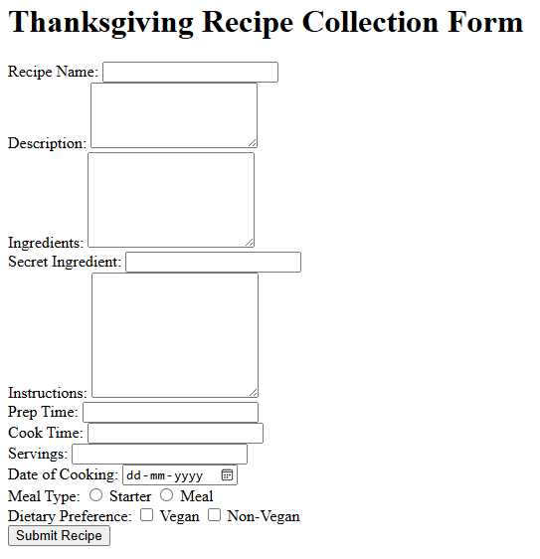
Html Structure Done
Let's Style it Now
Notes:
Objective:
Review the code till now
Teacher Instructions:
Recap the key points.
Encourage interactive discussion and exploration of form elements like text inputs, checkboxes, and submit buttons.

Slide 18
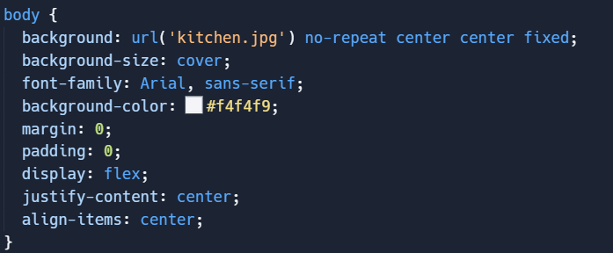
Working with the Project
CSS Code Explanation
Styling the Body
Notes:
Objective:
Explain the CSS code for styling the body of the webpage.
Teacher Instructions:
Display the screenshot of the CSS code.
Explain the styling for the body:
background: Sets a fixed background image (kitchen.jpg) centered on the page.
background-size: cover: Ensures the background image covers the entire background area.
font-family: Arial, sans-serif: Specifies Arial or sans-serif as the font for text.
background-color: #f4f4f9: Sets a background color (#f4f4f9) as a fallback behind the image.
margin: 0: Removes default margin around the body.
padding: 0: Removes default padding inside the body.
display: flex: Turns the body into a flex container.
justify-content: center: Centers content horizontally.
align-items: center: Centers content vertically.

Slide 19
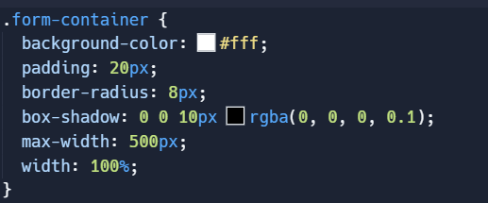
Working with the Project
Styling the Form Container
Notes:
Objective:
Explain the CSS code for styling the form container.
Teacher Instructions:
Display the screenshot of the CSS code.
Explain the styling for the Form Container:
background-color: #fff;: Sets the background color to white.
padding: 20px;: Adds 20 pixels of padding inside the container.
border-radius: 8px;: Rounds the corners of the container with an 8-pixel radius.
box-shadow: 0 0 10px rgba(0, 0, 0, 0.1);: Applies a subtle shadow effect around the container for depth.
max-width: 500px;: Sets the maximum width of the container to 500 pixels.
width: 100%;: Ensures the container spans the full width of its parent element.

Slide 20
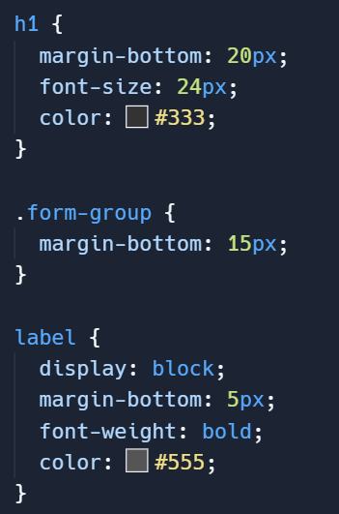
Working with the Project
Styling the heading form-group and label
h1: Sets margin below (20px), font size (24px), and color (#333).
.form-group: Sets bottom margin to 15px.
label: Blocks are displayed, with bottom margin set to 5px
Notes:
Objective:
Explain the CSS code for styling heading, form group and label.
Teacher Instructions:
Display the screenshot of the CSS code.
Explain the styling for the h1:
h1: Targets all <h1> elements.
margin-bottom: 20px;: Adds a bottom margin of 20 pixels to create space below the heading.
font-size: 24px;: Sets the font size of the heading to 24 pixels.
color: #333;: Defines the text color as dark gray (#333).
Explain the styling for the label:
label: Targets all <label> elements.
display: block;: Makes labels behave like block elements, ensuring they start on a new line.
margin-bottom: 5px;: Adds a bottom margin of 5 pixels to create space below each label.
font-weight: bold;: Makes the label text bold.
color: #555;: Sets the text color of labels to dark gray (#555).

Slide 21
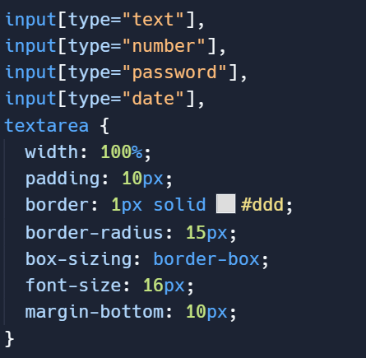
Working with the Project
Styling the input
Notes:
Objective:
Explain the CSS code for styling the table.
Teacher Instructions:
Display the screenshot of the CSS code.
Explain the styling for the table:
input[type="text"], input[type="number"], input[type="password"], input[type="date"], textarea: Targets <input> elements of type text, number, password, and date, as well as <textarea> elements.
width: 100%;: Makes the width of these elements 100% of their container.
padding: 10px;: Adds 10 pixels of padding inside the elements.
border: 1px solid #ddd;: Applies a 1-pixel solid border with a light gray (#ddd) color.
border-radius: 15px;: Rounds the corners of the elements with a 15-pixel radius, giving them a slightly rounded appearance.
box-sizing: border-box;: Ensures that padding and border are included in the element's total width and height, preventing unexpected resizing due to padding or borders.
font-size: 16px;: Sets the font size to 16 pixels for consistent text appearance.
margin-bottom: 10px;: Adds a bottom margin of 10 pixels to create space between elements.

Slide 22
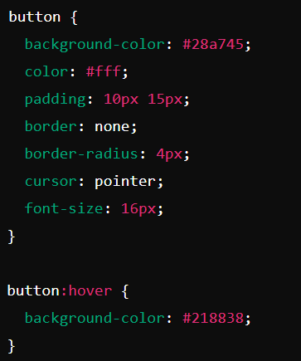
Working with the Project
Styling the Button and hover effect
Styles the button with green background, white text, padding, border radius, and cursor pointer.
On hover, darkens the background color for visual feedback
Notes:
Objective:
Explain the CSS code for styling the table cells.
Teacher Instructions:
Display the screenshot of the CSS code.
Explain the styling for Button:
button: Targets all <button> elements.
background-color: #28a745;: Sets the background color to a green shade (#28a745).
color: #fff;: Sets the text color to white.
padding: 10px 15px;: Adds 10 pixels of padding on the top and bottom, and 15 pixels on the left and right.
border: none;: Removes the default button border.
border-radius: 4px;: Rounds the corners of the button with a 4-pixel radius.
cursor: pointer;: Changes the mouse cursor to a pointer to indicate the button is clickable.
font-size: 16px;: Sets the font size to 16 pixels for the button text.
button:hover: Targets the button when hovered over by the mouse.
background-color: #218838;: Changes the background color to a darker shade of green (#218838) when hovered.

Slide 23
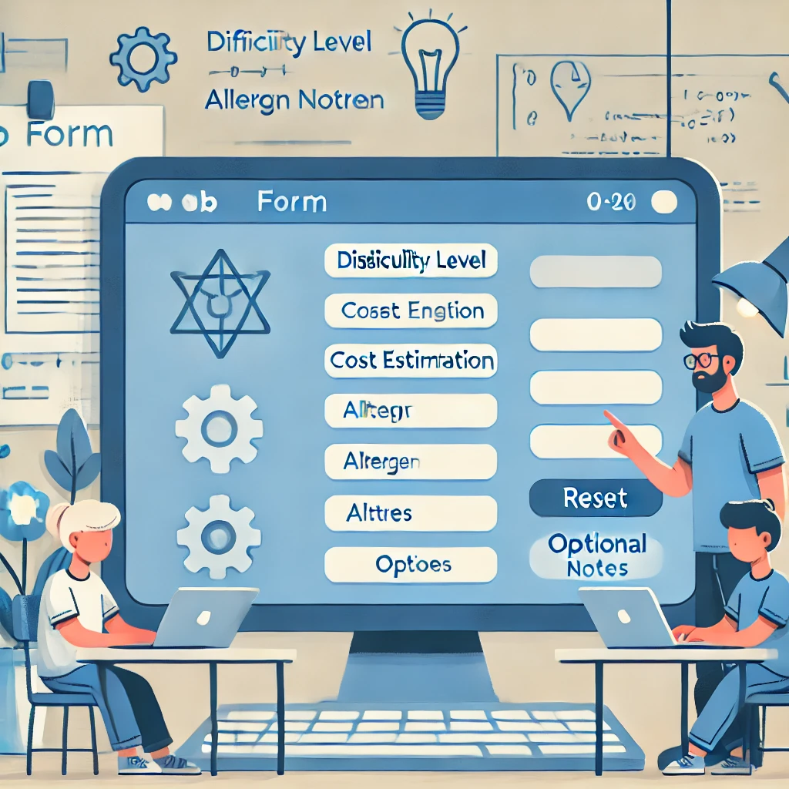
Now it's your turn!
Task:
Add a "Reset" button to clear all form fields if the user decides to start over.
Consider adding more specific fields such as difficulty level, cost estimation, allergen information, or a field for optional notes.
Instructions: Fill out the form with your favorite Thanksgiving recipes. Include the recipe name, description, ingredients, secret ingredient (password), cooking instructions, preparation time, cook time, servings, date of cooking, meal type, and dietary preferences. Ensure all fields are accurately filled out and submit the form to collect and share your recipes.
Notes:
"Students' Activity"
Objective:
Engage students in a hands-on activity to reinforce learning.
Teacher Instructions:
Present the student activity task:
Adding more input fields and the reset button
Provide instructions for the activity:
Review the existing code and identify where to add new input fields.
Adjust CSS properties to enhance the visual design of the webpage.

Slide 24

How to Save & Share the project.
Replit offers autosave option – so not worry about the same.
To share project with someone in view mode: just copy the link from the URL bar, and share the link
To share the project for collaboration
Click on "Invite" from the top right corner
If you know the username, type it in the box and click on invite
You can also turn on the toggle button "private join link" to create a public collaboration link and invite members to edit your code.
Notes:
Instructions for the Teacher:
Explain how to save and share projects on Replit, including the options for collaboration.
Emphasize the importance of sharing projects for feedback and collaboration.

Slide 25


What CSS property ensures that the background image covers the entire viewport and remains fixed in the center?
A) background-color
B) background-size
C) background-repeat
D) background-attachment
Notes:
Answer: D) background-attachment

Slide 26
Which HTML element is used to create a password input field in the form?
A) <input type="password">
B) <input type="text">
C) <textarea>
D) <input type="checkbox">
Notes:
Answer: A) <input type="password">

Slide 27
How is the font family specified for the entire document?
A) font-family: Arial, sans-serif;
B) font-type: Arial, sans-serif;
C) font-style: Arial, sans-serif;
D) font-format: Arial, sans-serif;
Notes:
Answer: A) font-family: Arial, sans-serif;

Slide 28

What have we learnt?
Today We Learned:
HTML Form Elements: We explored various HTML form elements such as text inputs, textareas, password inputs, radio buttons, checkboxes, and date inputs.
Form Validation: Discussed how to use the required attribute to enforce mandatory fields and ensure data integrity before submission.
Notes:
Objective:
Summarize the key learnings from the lesson.
Teacher Instructions:
Review the key points learned in the lesson:
HTML Form Elements: We explored various HTML form elements such as text inputs, textareas, password inputs, radio buttons, checkboxes, and date inputs.
Form Validation: Discussed how to use the required attribute to enforce mandatory fields and ensure data integrity before submission.
CSS Styling: Applied CSS styling to enhance the appearance and usability of our form, including background images, box shadows, padding, and border-radius.
Responsive Design: Considered the importance of responsive design principles to ensure our form looks good and functions well across different devices and screen sizes.
Submission: Understood the basics of form submission using the action and method attributes, along with a submit button to collect and process user input.

Slide 29
What have we learnt?
SS Styling: Applied CSS styling to enhance the appearance and usability of our form, including background images, box shadows, padding, and border-radius.
Responsive Design: Considered the importance of responsive design principles to ensure our form looks good and functions well across different devices and screen sizes.
Submission: Understood the basics of form submission using the action and method attributes, along with a submit button to collect and process user input.
Notes:
Objective:
Summarize the key learnings from the lesson.
Teacher Instructions:
Review the key points learned in the lesson:
HTML Form Elements: We explored various HTML form elements such as text inputs, textareas, password inputs, radio buttons, checkboxes, and date inputs.
Form Validation: Discussed how to use the required attribute to enforce mandatory fields and ensure data integrity before submission.
CSS Styling: Applied CSS styling to enhance the appearance and usability of our form, including background images, box shadows, padding, and border-radius.
Responsive Design: Considered the importance of responsive design principles to ensure our form looks good and functions well across different devices and screen sizes.
Submission: Understood the basics of form submission using the action and method attributes, along with a submit button to collect and process user input.

Slide 30

Homework Discussion
Notes:
Instructions for the Teacher: Facilitate a discussion about the homework assignment.

Slide 31

Brain Booster Bonus
Create a "Personal Portfolio Form" using HTML and CSS.
Use HTML for structuring the form with fields like project titles, descriptions, technologies used, and URLs. Apply CSS for styling with backgrounds, borders, and spacing. Ensure usability on different devices and include validation for required fields.
Notes:
Objective: Design a form for users to input personal project details, skills, education, and contact information.
Instructions:
Use HTML for structuring the form with fields like project titles, descriptions, technologies used, and URLs. Apply CSS for styling with backgrounds, borders, and spacing. Ensure usability on different devices and include validation for required fields.
This project builds HTML and CSS skills while creating a professional form for showcasing personal achievements.

Slide 32

Be Skeptical of Promises
If something online sounds too good to be true, like 'free games for life,' it could be a trick.
Oliver saw an ad online promising "free games for life" and eagerly clicked on it, hoping for a great deal.
Instead, his computer got infected with malware, causing a lot of problems.
The moral of the story: don't believe ads or emails promising free stuff without checking with an adult first, as it could be a trick.

